Slide 2
Northwoods Wreaths and Noble Valley Farms
2017 Fall Wreath Sale
Illinois and Wisconsin based companies established since 1982 to provide fundraising services across the Midwest. Combined, both Companies service over 400 groups helping them generate over $1,100,000 in net profits annually.
Our staff:
Brittany Burmeister
262-409-5047, Brittany.Burmeister@Scouting.org
Patty Freuler
414-443-2849, Patty.Freuler@Scouting.org
Primary contact: Wreaths@ThreeHarborsScouting.org
Our Vendors:
Andy- 30+ years in wreath experience
Manages Product Production and Operations
Bill - 15+ years experience
Manages Sales , Customer Care, and Product Fulfillment

Slide 3
Three Harbors Council 2017 Wreath Sale
A council wide program focused to sell unique, quality evergreen products in Southeast Wisconsin.
Sale begins on September 15 and ends October 16
Orders are entered online by November 5th
Orders picked up on November 11th
Payment due on November 11th, the Council will cash
post-dated checks made out to BSA on December 5th.
Two convenient pick up locations:
South - Camp Oh-Da-Ko-Ta in Burlington
North - State Fair Park in West Allis
To Place an Order: Head to www.ThreeHarborsScouting.org/ProductSale and click North for State Fair Orders or South for Oh-Da-Ko-Ta orders. If you have an existing username and password, you can log in and continue. If you are new, please click “Request New Account.” Once approved, you can place your order.

Slide 4
Diverse Range of Products!
Balsam Wreaths
6 Sizes available
Noble Fir Wreaths
4 Sizes Available
Specialty Products
Mixed Door Swag
Candy Cane
Cross
Regular and Supersized Outdoor Planters
High End, Decorator Wreaths
Firestarter Baskets
Garland
Fallen Hero Wreaths

Slide 5
Commission and Incentives
Commission:
25 % on All Items
Incentives:
Top 3 Fallen Hero Wreath Salesmen
Receive an iPad
Blitz Weekend (September 15-17)
Most Fallen Hero Wreaths sold qualifies for a Lego Robotics Kit
Top 12 Units who sell at least $4,500 in total receive Free Delivery!
Delivery will be on November 9 &10
No combining unit orders!

Slide 6
2017 Popcorn Kickoff
THREE HARBORS COUNCIL

Slide 7
What Are We Selling?

Slide 8
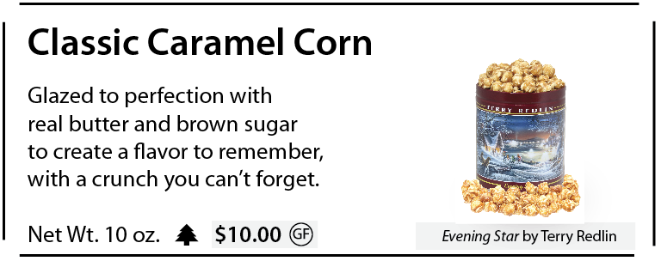
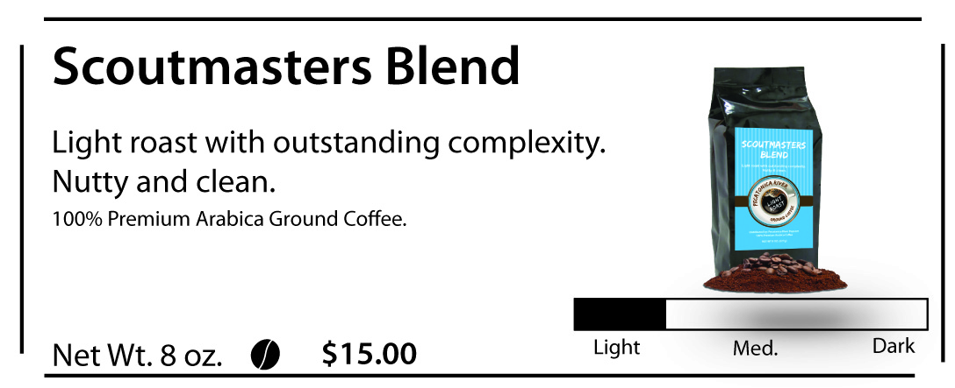
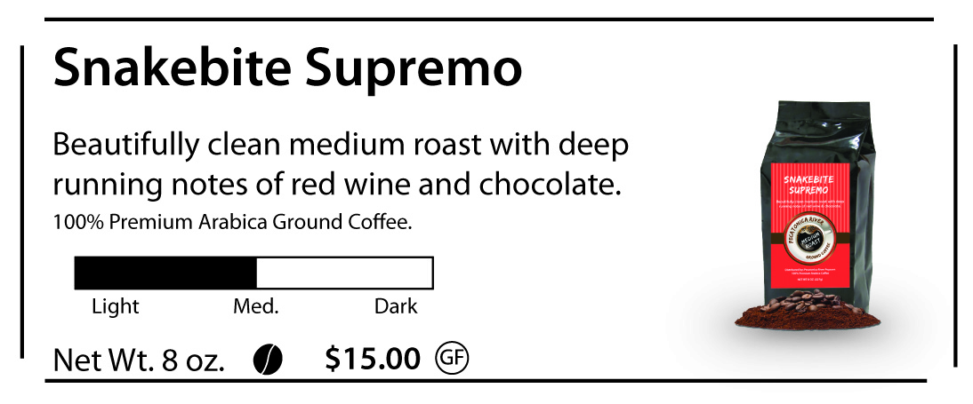
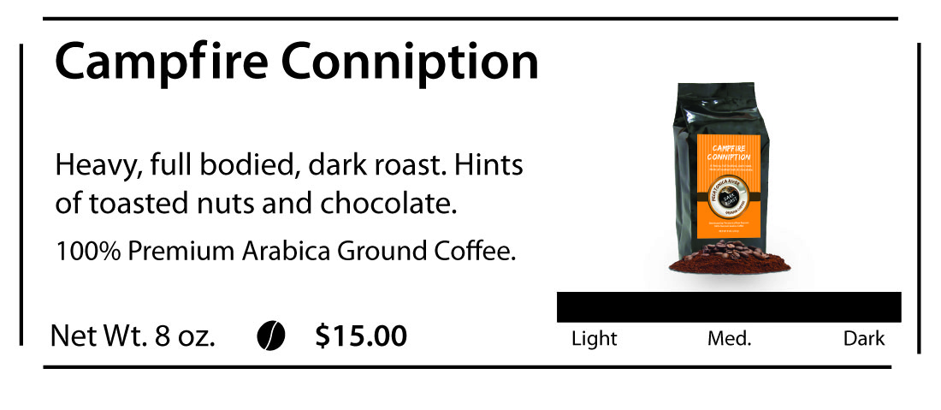
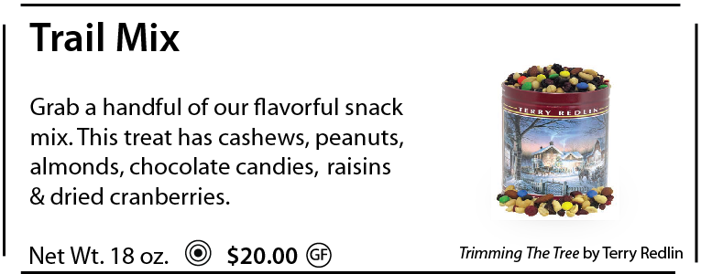
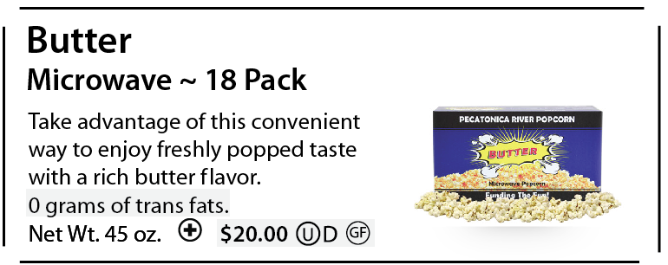
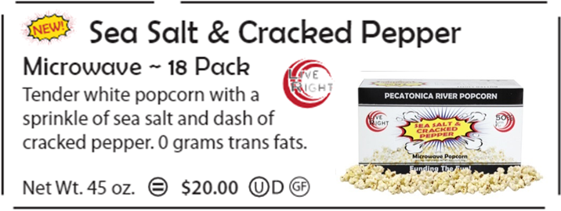
2017 Popcorn Flavors $10-$20

Slide 9
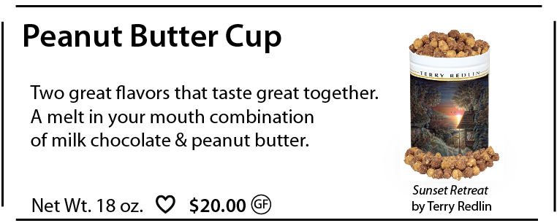
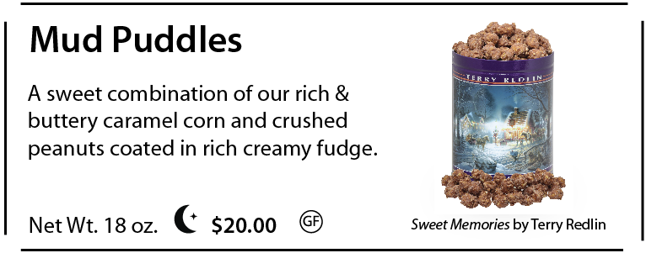
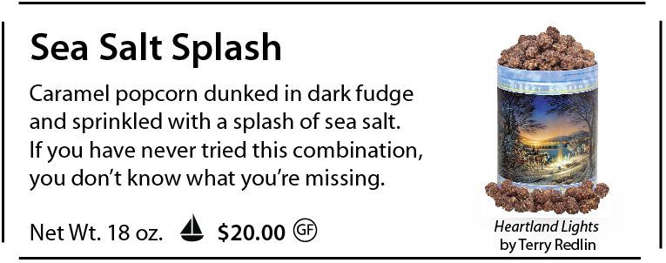
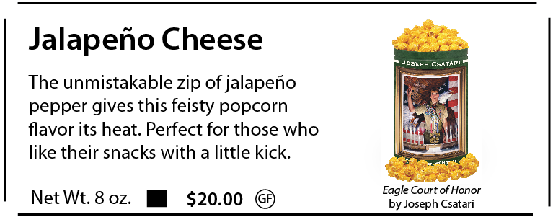
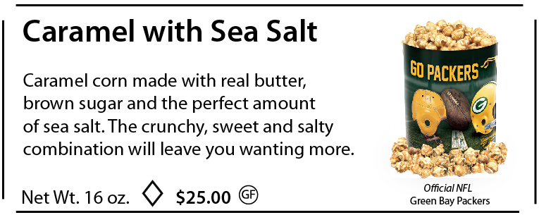
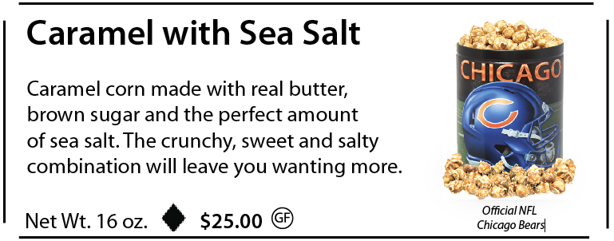
2017 Popcorn Flavors $20-$25

Slide 10
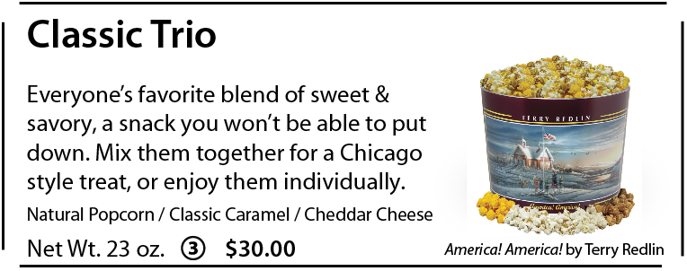
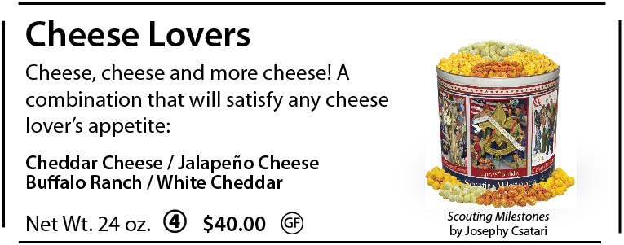
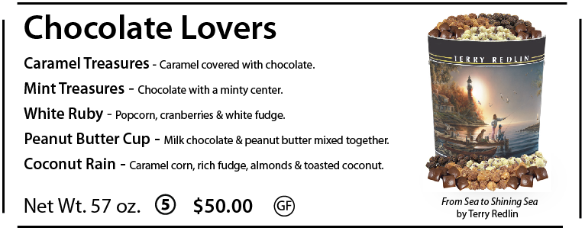
2017 Popcorn Flavors $30-$50

Slide 11
Military/Food Donations $30/50
For the Health Conscious
Military Donation
Food Bank Donation
Allows customers to purchase popcorn for the men and women serving our country and support Scouting at the same time.
Donation will be made up of popcorn from the sale flyers and distributed throughout the Kenosha, Milwaukee and Racine County area.

Slide 12
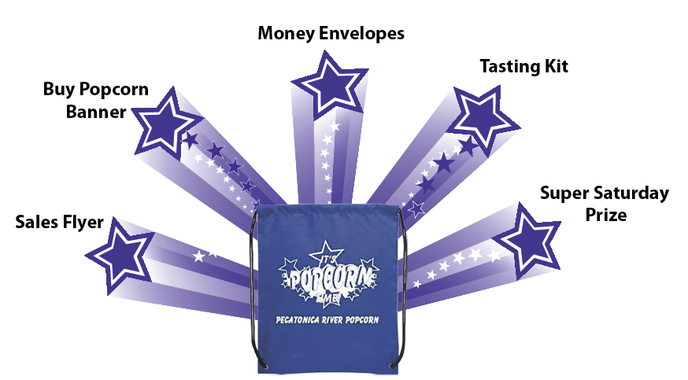
Kick Off – In the Bag

Slide 13
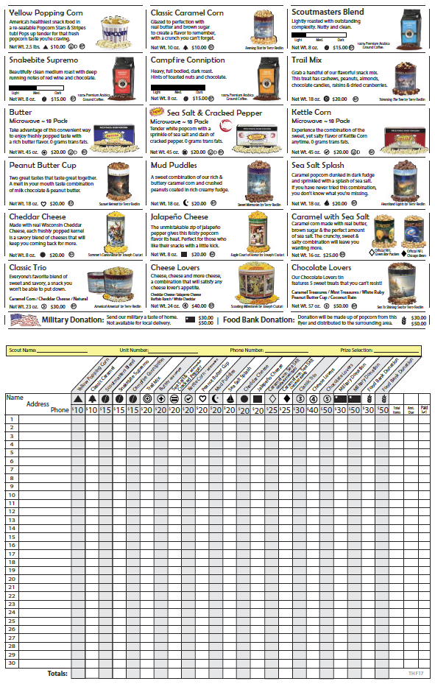
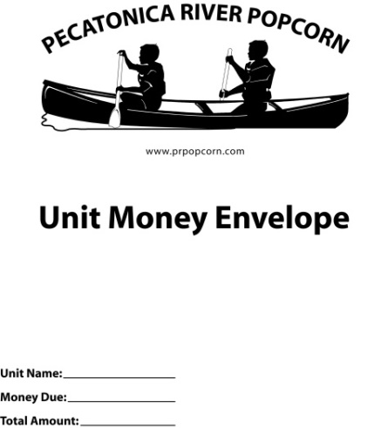
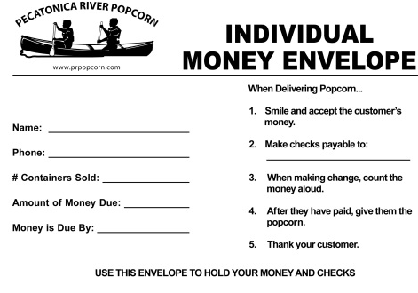
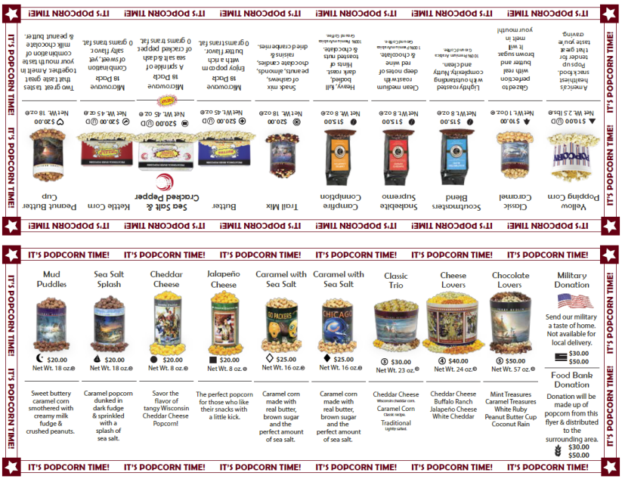
Sales Flyers/Envelopes

Slide 14
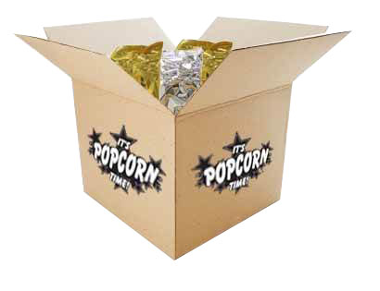
Popcorn Tasting Kits
-How to Conduct a Tasting Session-
The purpose of a tasting session is to have each boy try 1 or 2 kernels of each flavor. Once everyone has tasted each flavor, have the boys vote on which popcorn they liked best! Tally the votes and determine which flavors were everyone’s favorites. Have fun with it!
-Why Tasting Sessions are going to help rocket our sales-
By conducting a tasting session for your group you create product familiarity and product knowledge. Now each scout can use the tasting results as a selling tool! For example, when the boys are at someone’s door selling and the buyer says “I don’t know what to get” the boy can say “My pack did a taste testing session and we decided that Caramel was the best, but I like Jalapeno Cheese so you should buy them both!”
Enjoy your Tasting Kits and good luck selling this season!
Sincerely, Your Friends at Pecatonica River Popcorn
Notes:
14

Slide 15
Bullet Board:
10 Bullet Points To A Great Sale

Slide 16
Show & Sell Banner

Slide 17
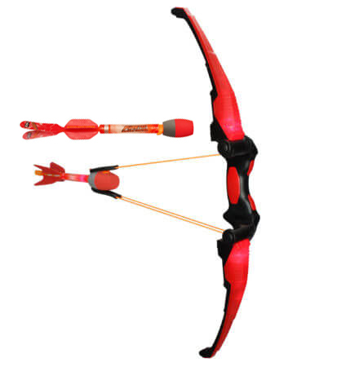
Super Saturday
Fun-filled day of events enriched
with opportunity for Scouts. The
day is designed to stimulate Scout
sales and encourage interaction with customers.
Entire unit gathers on a Saturday
morning.
The entire unit goes to a house to learn some techniques for selling door to door and to gain some confidence.
The Scouts, leaders and parents then divide and blanket the neighborhood to see who can make the most sales.
Meet back at the starting place in a specified amount of time and give the prize away.

Slide 18
4 Ways to Sell Pecatonica River Popcorn
Show & Sell/Show & Deliver
Setting up a display of your popcorn at a high traffic area is an easy way to increase your sale!
(Popcorn is ordered in advance on consignment from the Council)
Combines the Show & Sell (Products ordered in advance) and Take Order (Going door-to-door). One Stop Selling!
(Product is taken door-to-door and delivered on the spot)
Take Order
The traditional way for Scouts to sell popcorn is going door-to-door in the community. Customers place their order on the take order form and it gets delivered after the sale.
(Unit tabulates individual Scout sales into one Unit Order)
Online Sales
Customers can support Scouts from across the country with prpopcornstore.com. Each Scout gets credit for what they sell.
(Unit leaders register each boy, seller ID’s are emailed along with script)

Slide 19
Online Sales – prpopcornstore.com
Online selling allows Scouts to sell to faraway friends and family. 70% of every purchase goes back to Scouting.
Why sell online?
No deliveries! PRP ships the product directly to the consumer.
Emails sent out each time an order ships so that the unit leader and Scout can track sales.
It’s easy! Scouts register to sell with their unit leader via the Unit dashboard.
Three options to choose from:
2 gallon tin
3 gallon tin
Military Donation ranging from $10 - $100.
Sales count towards prize levels.

Slide 20
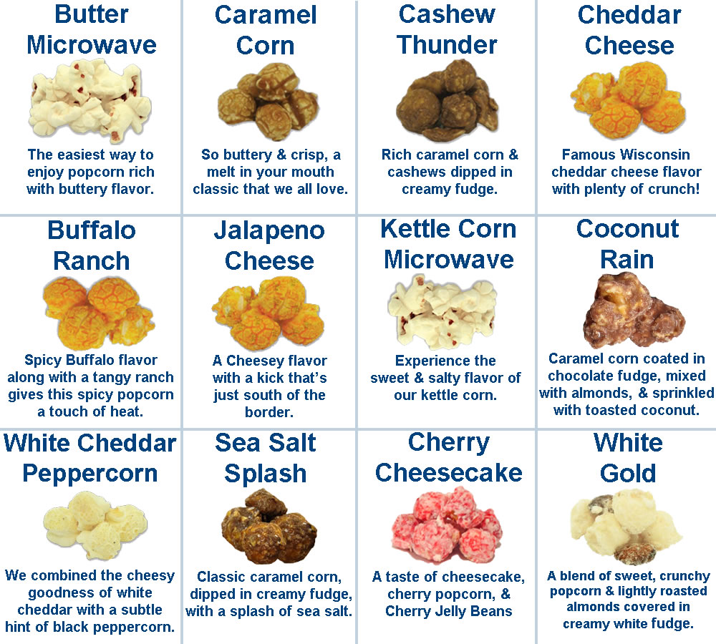
Online Flavors
Customers can choose their favorite 3 flavors from 12 unique options to fill their tins.

Slide 21
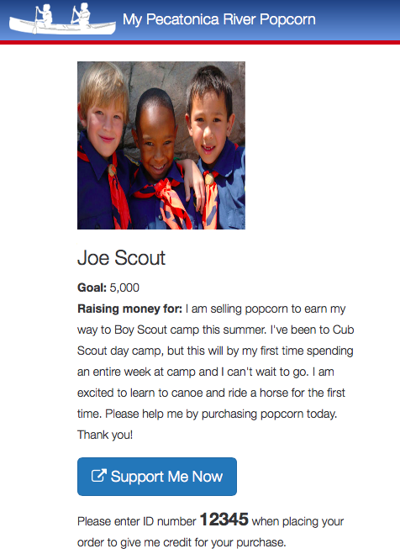
Online Sales – MyPRPopcorn.com
My PR Popcorn is a secure, online platform that helps Scouts and their parents sell more popcorn by easily promoting their sale to family and friends online using your own custom profiles. Scout profiles can be setup and managed using a web browser (www.MyPRPopcorn.com) or Apple or Android smart phone by downloading the My PR Popcorn app on the Apple App store or Google Play store.
Personable email to send to family
and friends.
Parent can record video message of Scout
telling about unit and why the popcorn
sale is important through the My PR
Popcorn app.
PLAY NOW

Slide 22
Sell $2,500 To Enter Winners Circle
Winners Circle
Everyone has a chance to win
All Scouts that sell $2,500 or more have their choice of one prize from Pecatonica Rivers’ Winners Circle. All Scouts that sell $4,000 or more have the choice of one prize but have 3 additional options to choose from. Unit leader will enter their Scout’s:
www.prpopcorn.com
Log into your unit profile
Click “Enter Scout into Winners Circle”
**One prize per winner**

Slide 23
Bonus Incentives
Popcorn Sale Patches
Super Saturday Prize
Pecatonica River Popcorn $2,500 and $4,000 Winners Circle
Any Scout who sells at least one item will receive a popcorn sale patch.
Every unit receives a Z-Curve bow to help rocket their sales. Use the bow to generate excitement at the kick off. Use the bow in whatever way helps the unit to get excited about the sale.

Slide 24
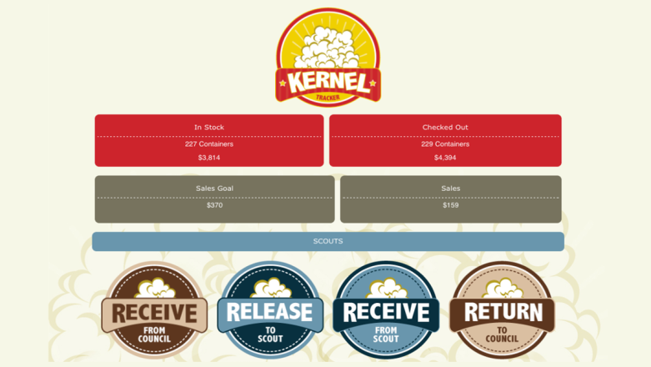
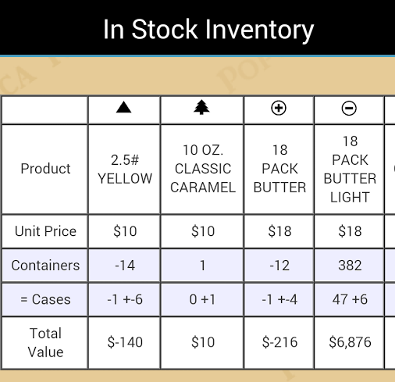
www.PRPopcorn.com
Kernel Tracker App
Kernel Tracker helps you easily manage Show & Sell inventory down to the individual container:
Product Received from Council
Product Given to Scouts
Product Returned by Scouts
Product Returned to Council.
You can even see exactly what products each Scout has checked out and how much they owe.

Slide 26
Helpful Tips

Slide 27
Donation Receipts

Slide 28
Sorry We Missed You Cards

Slide 29
Popcorn Receipts

Slide 30
Nutritional Information

Slide 31
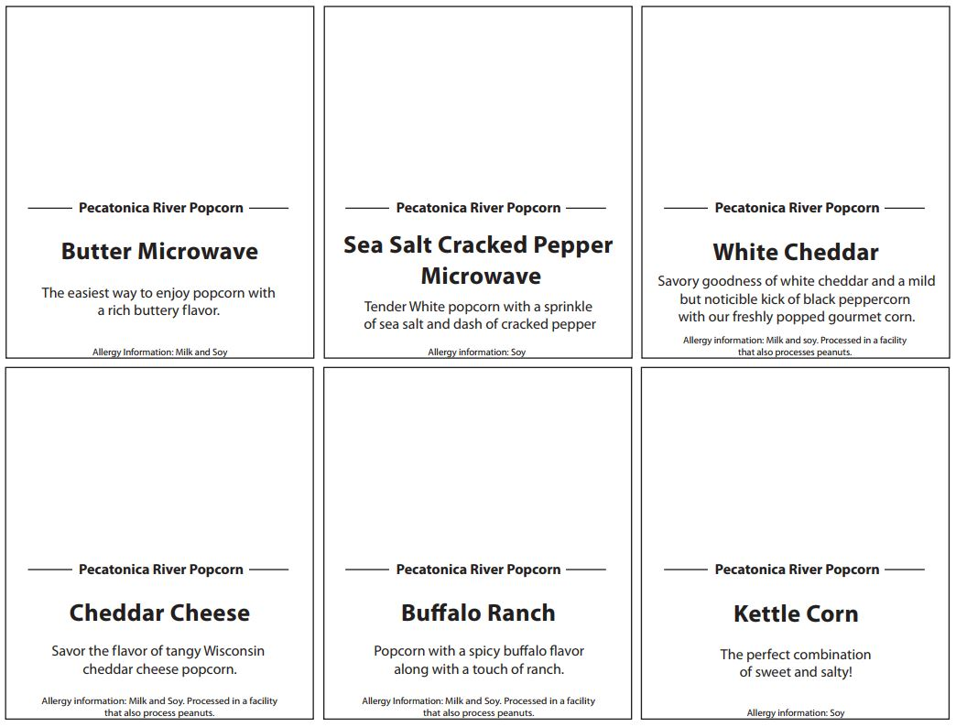
Tasting Kit Cards

Slide 32
Scout Boss

Slide 33
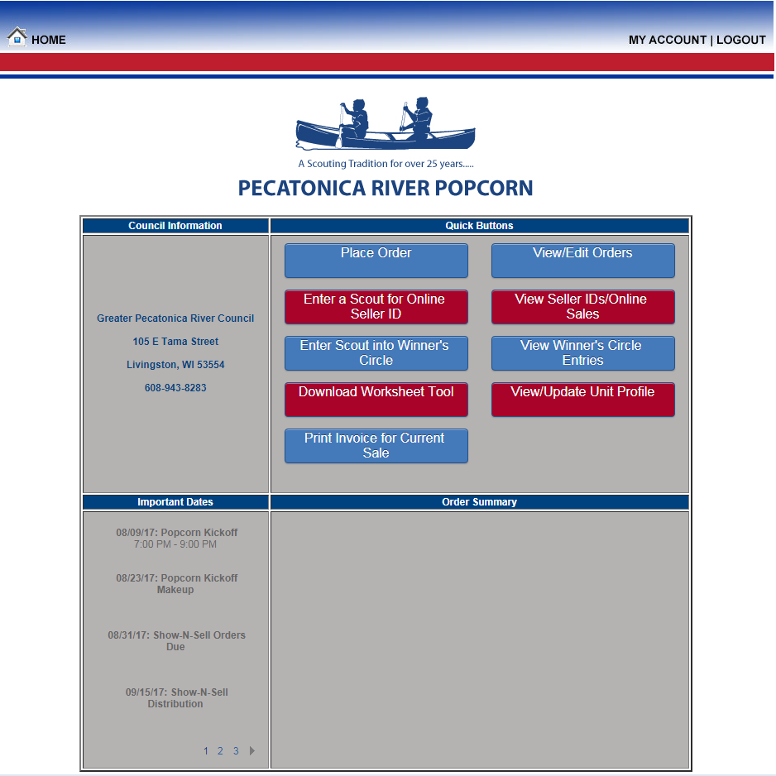
Scout Boss

Slide 34
Scout Boss
Show-N-Sell orders are ordered in cases only.
Take Orders are ordered in containers only.
You have the ability to edit your order by logging into your unit profile up until the council approves the order.

Slide 35
Scout Boss

Slide 36
Scout Boss

Slide 37
Thank You!
Questions or Comments?

Slide 38
Important Dates
August 30 Show & Sell Orders Due Online by Units
September 12 Show & Sell Pick-Up, Milwaukee
September 13 Show & Sell Pick-Up, Kenosha/Racine
September 15 Sale Starts
October 16 Sale Ends
October 23 Milwaukee Reconciliation Day
October 24 Kenosha/Racine Reconciliation Day
November 9 Milwaukee Take-Order Pick-Up
November 10 Kenosha/Racine Take-Order Pick-Up
December 5 Post-Dated Checks Cashed

Slide 39
Warehouse Locations
C.H. COAKLEY
N54 W13901 Woodale Dr
Menomonee Falls, WI 53051
WARREN INDUSTRIES
2825 4 Mile Rd
Racine, WI 53404

Slide 40
Warehouse Hours
Milwaukee Scout Service Center
Wednesdays during sale 12:00-5:30
Fridays during sale 12:00-5:30
Saturdays during sale 9:00-10:30
Warren Industries (Racine/Kenosha area)
Thursdays during sale 3:00-5:30
Please contact Steven or Patty to confirm an additional product order! We want to make sure we have product in stock and someone there to help!
PATTY FREULER
414-443-2849
Popcorn@ThreeHarborsScouting.org
STEVEN IDZIKOWSKI
414-443-2858
Steven.Idzikowski@Scouting.org

Slide 41
Popcorn Sale Details
Choose your commission structure:
33% with Prize Program
OR
35% without Prize Program
Choose your methods of selling:
Take Order
Show & Sell
Selling Online

Slide 42
Return Policy
• Units cannot return, WITHOUT ANY EXCEPTIONS, more than 20% of their total Show & Sell at any point during the sale
• Units cannot place an order for initial Show & Sell for more than their units Fall 2016 Total Sale
• Undamaged product that was ordered for Show & Sell MUST be returned by Reconciliation Day
Chocolate Products may NOT be returned.
• Any product returned prior to Reconciliation Day are by appointment only and are subject to the 20% rule
• Light/Medium/Dark coffees and Cheese Lovers will be limited for Show & Sell order.

Slide 43
Unit and Leader Incentives
Extra Commission
Increase sale 10% ($2,500 minimum), unit gets 1% increase in commission of total retail sold
(Units must have sold in Fall 2016 to qualify)
Smart TV Drawing for Leaders
Attend Popcorn Training and increase sales to be entered in a drawing to win a Smart TV
Unit Kickoff Gifts
Each Units receives a $750 Club prize, a taste kit, a bullet board and a tote bag
Unit-Led Incentives
· Set $750 Goal for every Scout
· Top Seller Incentives
· Top Selling Den/Patrol earns a Pizza Party
· Pack/Troop/Crew Goal

Slide 44
Tools Available to Units
Popcorn Machine
Perfect for your Kickoff
Three Harbors Council will provide popcorn and bags to fill
Squareup.com
Request a free app and card reader via the Square Up Website
With its low transaction fee, Square Up is the perfect way to sell to those who do not carry cash
You can also purchase a Chip & Contactless (Apple Pay, etc.) Reader for $49
Banners
Borrow popcorn banners from Three Harbors Council for your next Show and Sell!

Slide 45
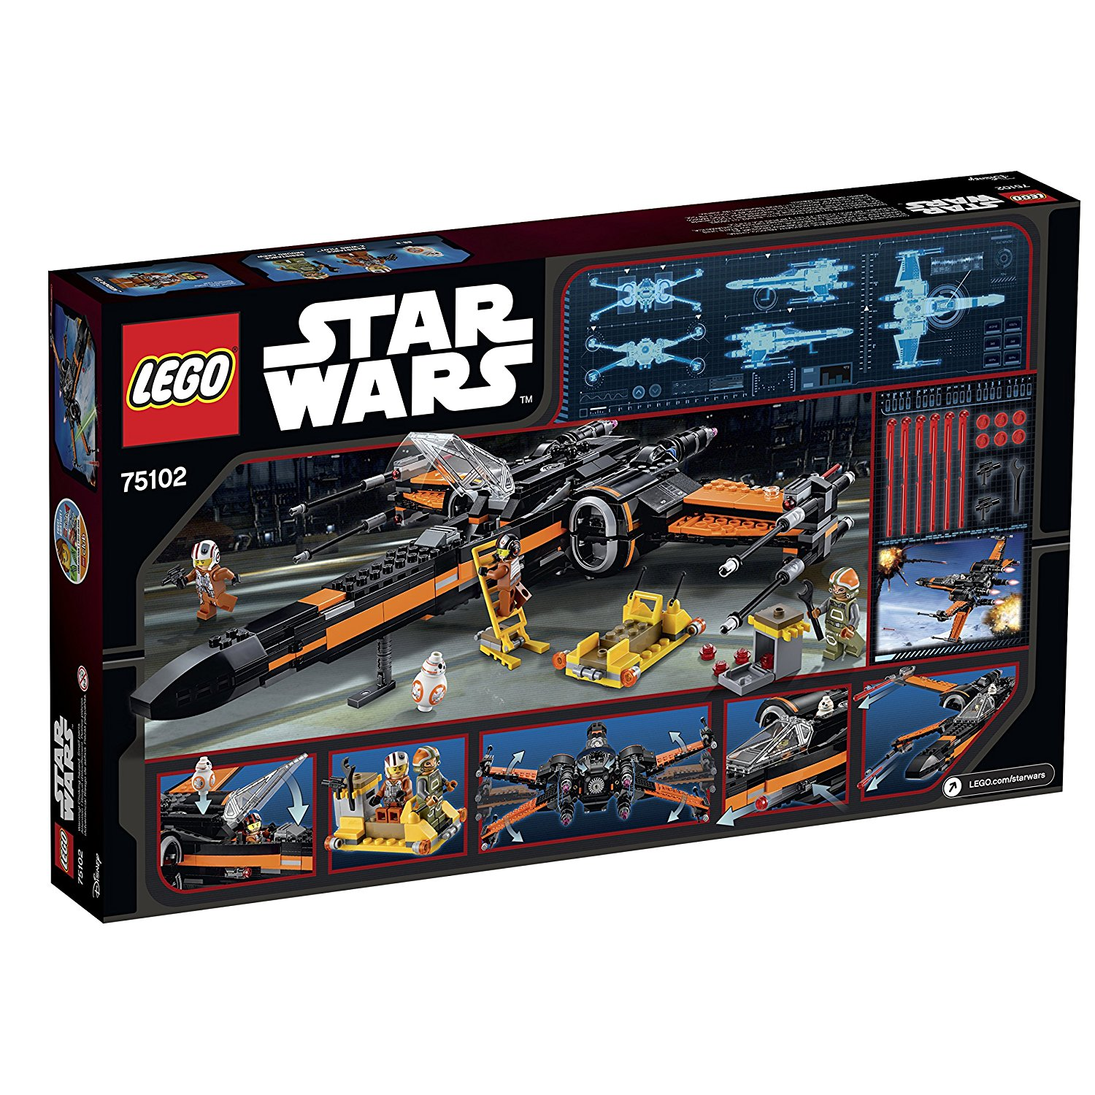
Blitz Weekend
Top 5 Sellers in the Council during the opening weekend win a LEGO Star Wars Poe's X-Wing Fighter!
Bonus Rewards
• Bonus Rewards are for ALL Scouts, at 33% and 35% commission.
• Turn in the Bonus Rewards spreadsheet by Reconciliation Day.
• Prizes will be ready to be picked up from the Scout Office by the end of December

Slide 46
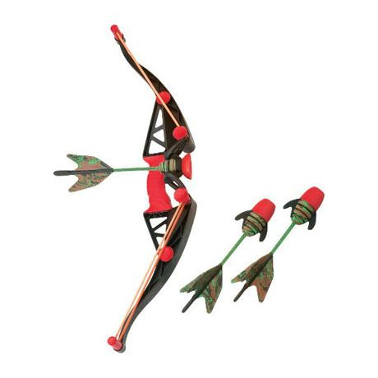
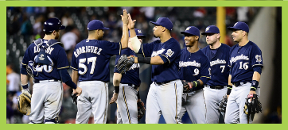
Bonus Rewards
Level 1: Sell $750
Sports Voucher, Z-Curve Bow,
$750 Club Patch
Level 2: Sell $1,250
(3) Country Springs Waterpark Passes + Level 1
Level 3: Sell $2,500
Prize from Winner’s Circle
+ Level 1 & 2
Level 4: Sell $4,500
Milwaukee Brewers Premiere Package + Level 1, 2 & 3
Level 5: Sell $7,500
2 Night Stay at the Great Wolf Lodge for a Family
of 4 + Level 1, 2, 3 & 4
Level 6: Sell $12,000
3 Night, 4 Day Trip to Legoland in Florida for a Family of 4
+ Level 1, 2, 3, 4 & 5
Level 7: Sell $16,000
3 Night, 4 Day Trip to
Universal Studios in Florida
for a Family of 4
+ Level 1, 2, 3, 4 & 5

Slide 47
Final Comments
Check your Kernel Journals
Take all the flyers you need
Call us if you need help or have a question
Use the resources on www.ThreeHarborsScouting.org/Popcorn
5 Keys to Unit Success
1. Unit Kernel Trained, Organized, and Pumped up
2. Plan your Unit's Program
3. Set a Goal
4. Inspirational and Fun Unit Kickoff
5. Unit incentives that every Scout will Enjoy

