Slide 1





Product Sales Kickoff
2026

Slide 2
Introduction
Nick Thornton
Amanda Hipper
Council Kernel
Jennifer Dahlen
Red Arrow Kernel
Mary Jackson
Southern Shores Kernel
TBD
Aurora Kernel
Cory Weber

Slide 3

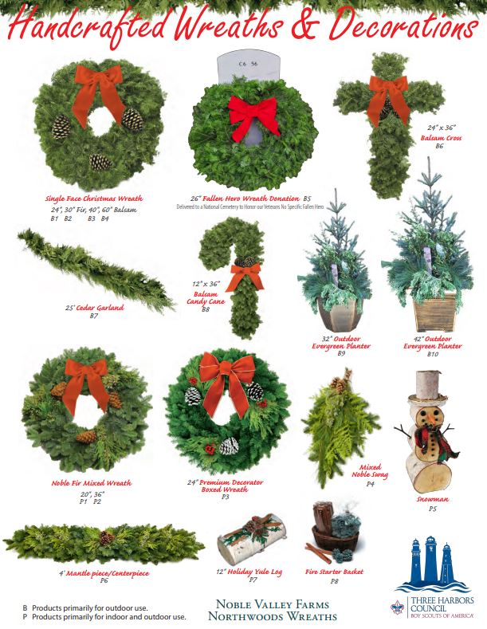
WREATHS

Slide 4
Sign up to Sell
First
  Sign up with Three Harbors Council
Second
  Sign up with Northwoods Wreaths.​
    Once you create a login, there is a 24 hour wait for approval.
A
B

Slide 5
The Sale: August 21 – October 23
Family & Friends
Door to door
Businesses
  Banks
  Car Dealerships
  Churches
Orders placed by Wednesday, October 28th on Northwoods site

Slide 6
Blitz Weekend: September 25-27
Fallen Hero Wreaths
$20 each​
Yes, they are included in the 20% commission.​
Wreaths are distributed directly to the cemetery.​
Top 5 Sellers receive a $100 Amazon Gift Card.

Slide 7
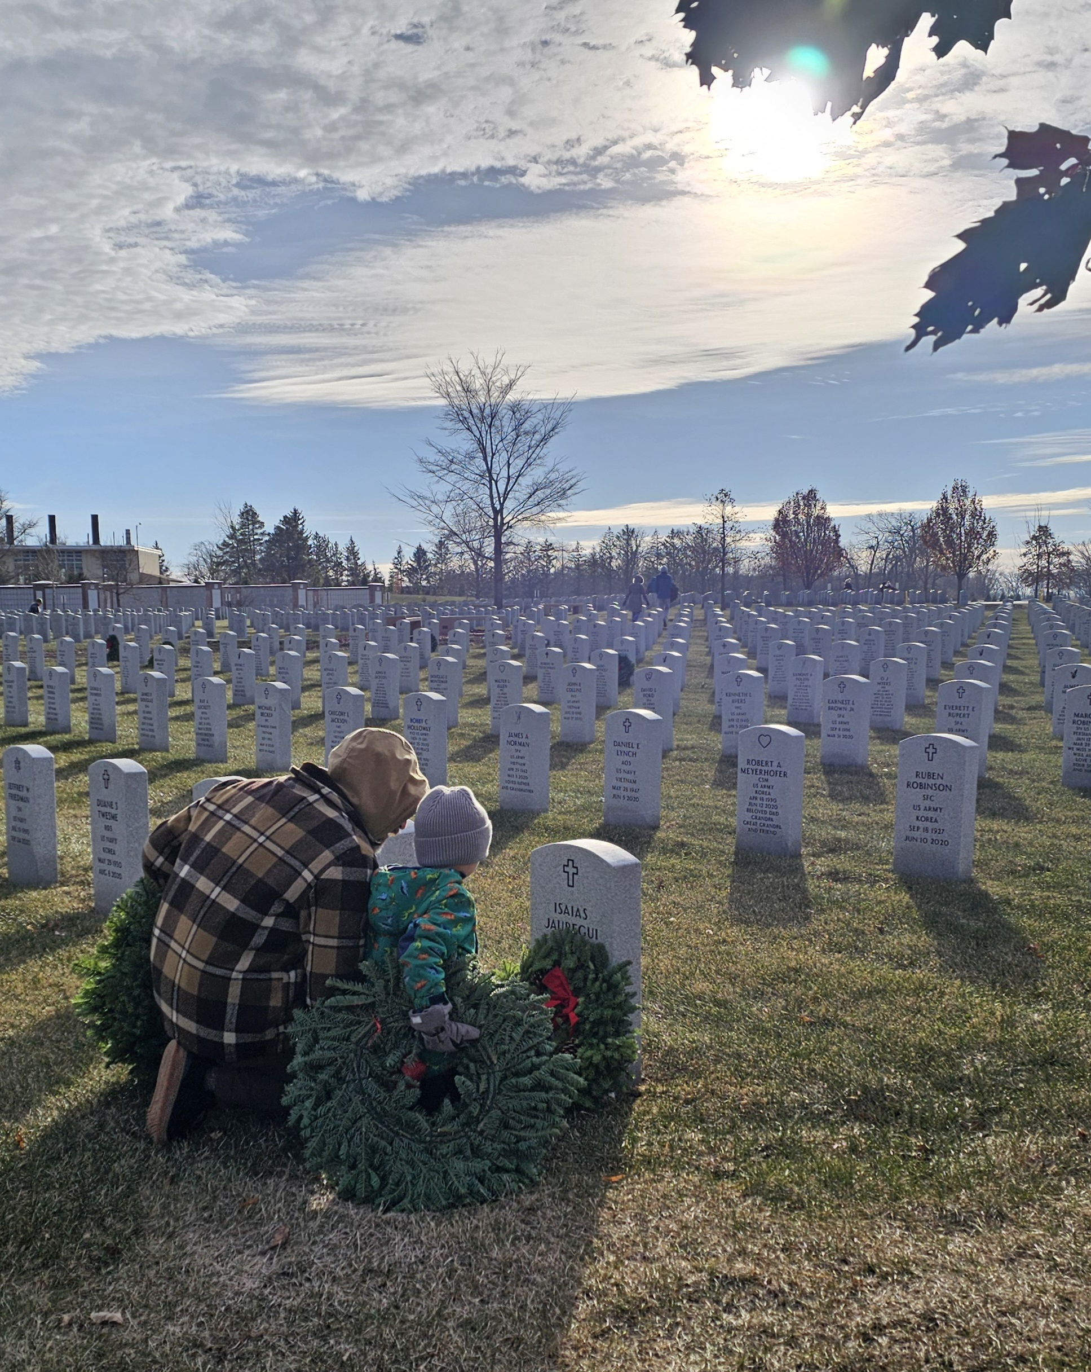
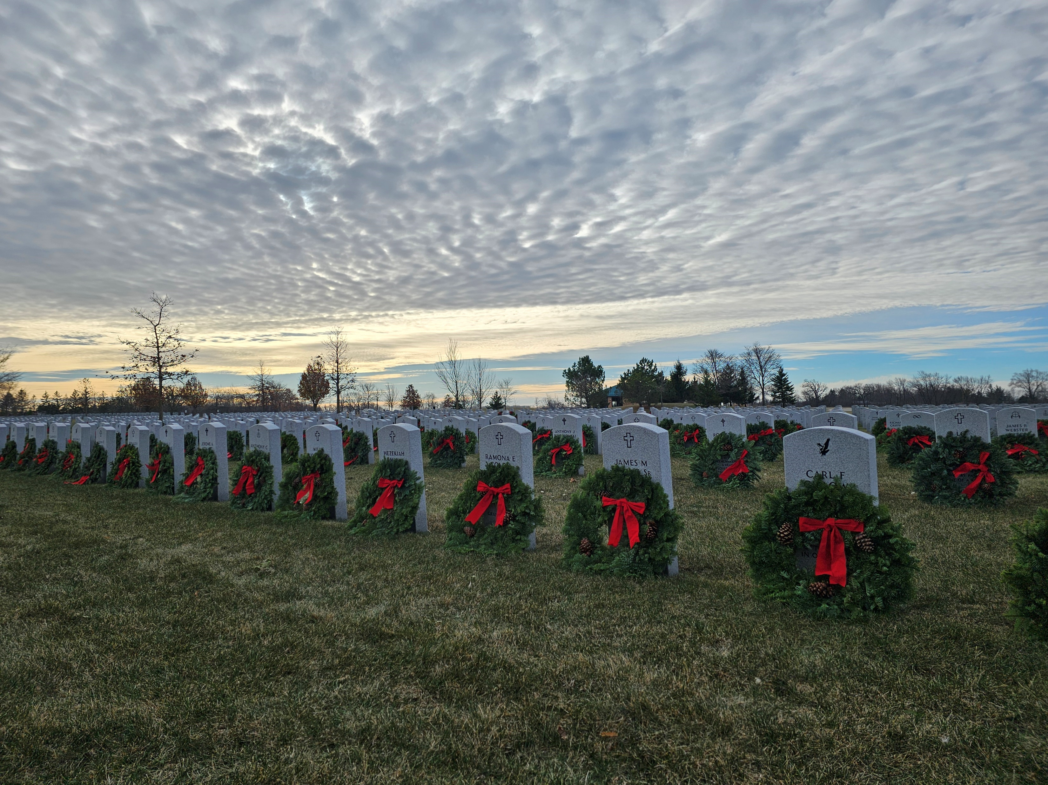
Fallen Hero Ceremony: December 5th
Southern Wisconsin Veterans Memorial Cemetery in Union Grove​

Slide 8
Wreath Distribution
Top 6 units with a total retail sale of $6,000 get delivery
Pick up at Waukesha Expo Center
Missing or Damaged
  Let us know as soon as possible – by November 21​
  All exchanges are made at Expo Center

Slide 9
Payment
Invoices are emailed to you from Three Harbors Council on November 24th
Make one unit check out to Three Harbors Council
  Mailed or in person at the Scout Service Center
  Have your invoice with your payment
Payment due Monday, December 7th

Slide 10
Commission
20% on retail total for each unit
The invoice you pay to Council is minus your commission.
Additional 5% commission earned if the unit attends this training and pays on time.​
  This commission will be deposited in the unit account before year’s end.

Slide 11
Prizes
All prizes come from Three Harbors Council​
Visa Gift Cards are earned at different sales levels​
  $500 - $1499 = $50​
  $1500 - $2499 = $150​
  $2500+ = $250​
1K Club – Those Scouts who sell $1,000+ qualify.
Top Seller Event – Those Scouts who sell $1500+ qualify.
C
D
*1K Club & Top Seller Event have individual sign-up links

Slide 12

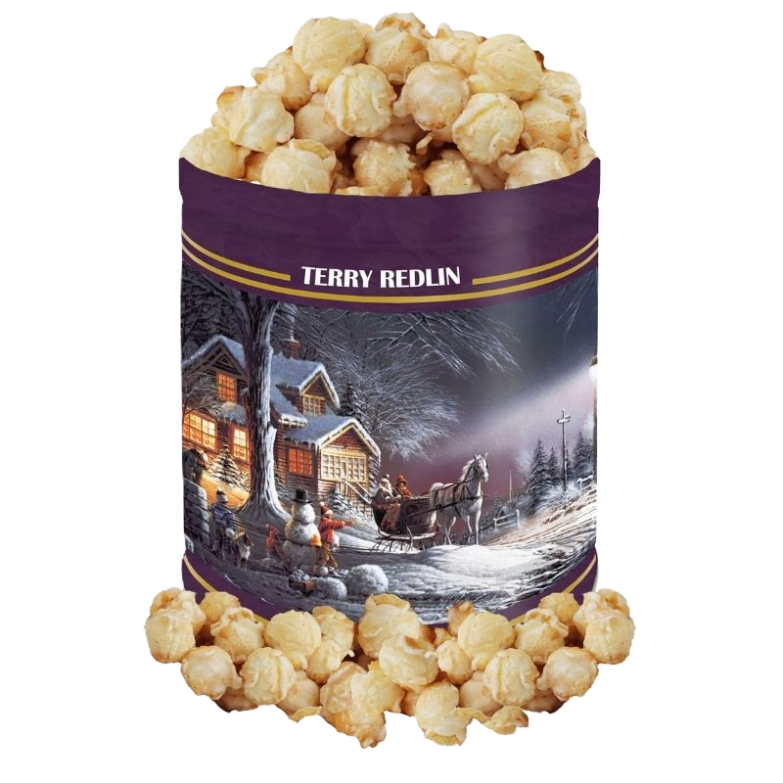

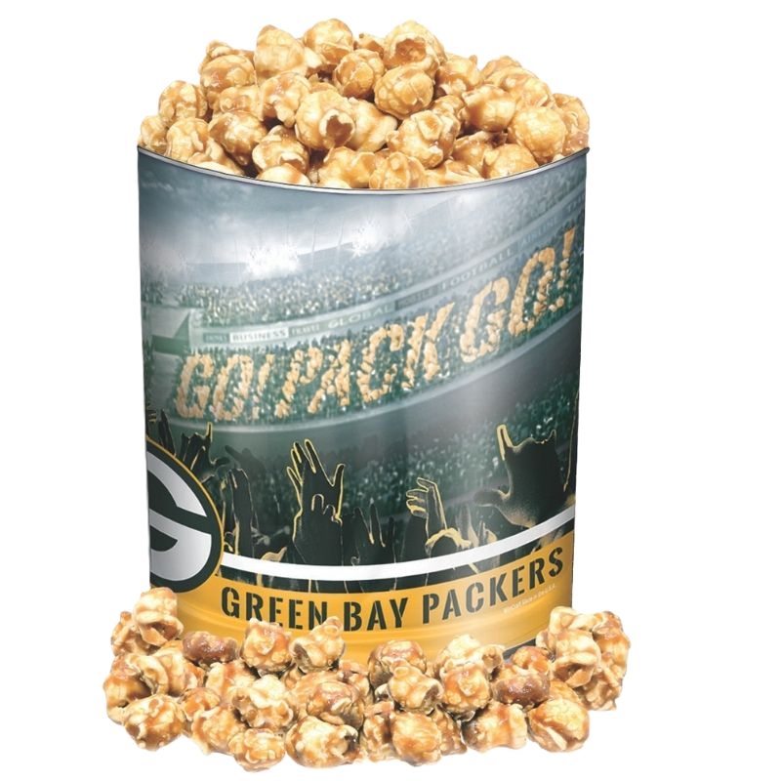

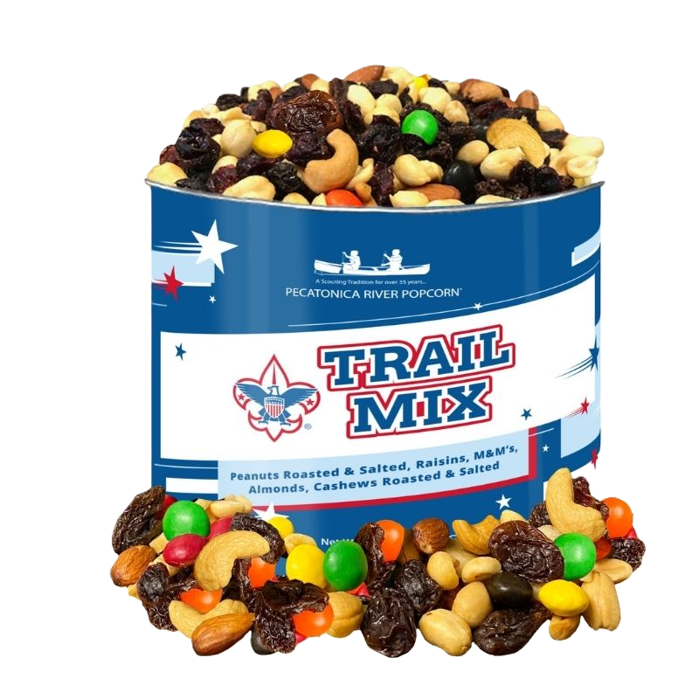
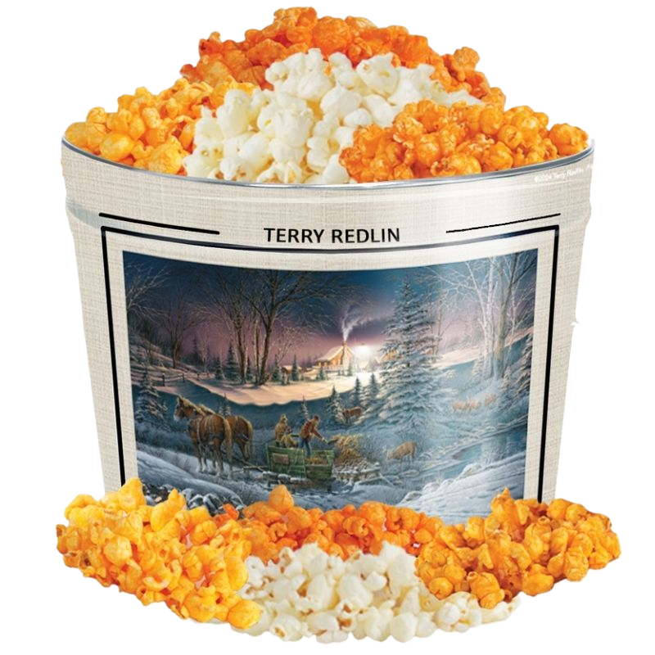
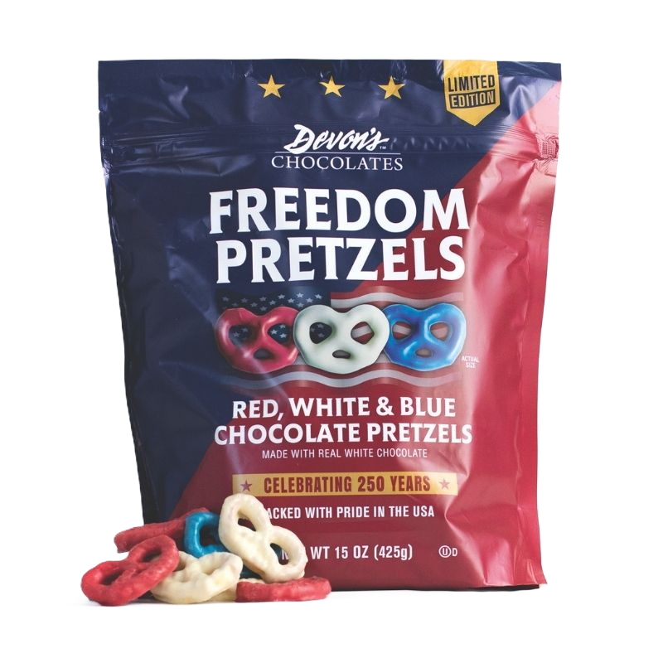

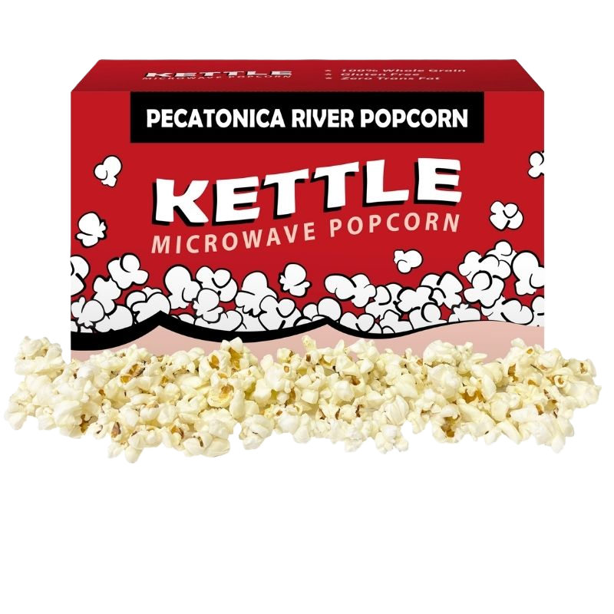
POPCORN
NEW
NEW FLAVORS
NEW

Slide 13
Sign up to Sell
First
  Sign up with Three Harbors Council
Second
  Sign up with Pecatonica
A
E

Slide 14
The Sale: August 21 – October 11
Show and Sell
Take Order
Online Sale*
  Starts August 1
  Ends November 15

Slide 15
The Sale: Show & Sell
Starts August 21 – Distribution Day
Orders must be in by Tuesday, August 4
Orders must be made in CASES
  Festival
  Pick and Save
  ASK NOW: Banks, Menards, Ace Hardware, Farm and
  Fleet, Beer Gardens, School Sports games, Churches,
  Homes for aging in Place

Slide 16
The Sale: Take Order
Door to door
Call your family and friends
Use Take to Work Tents
Orders are due October 14th
  Orders must be made in CONTAINERS

Slide 17
The Sale: Online
August 1 – November 15

Slide 18
Blitz Weekend: August 28-30
Only popcorn sold at this time will qualify
  Show and Sell
  Take
  Online
Submissions due on September 1st
  Scan and email results to popcorn@threeharborsscouting.org
Top 5 sellers receive a $100 Amazon Gift Card

Slide 19
Returns
Fill your Take Order with leftovers from Show and Sell
Submit your Return count in Pecatonica
Return your popcorn on October 16th
No damaged or opened containers will be accepted

Slide 20
Final Order
Submit your ‘take order’ in Pecatonica by October 14th
Distribution is November 6th

Slide 21
Damaged/Missing
Contact us!
* Don’t leave chocolate in your hot car *

Slide 22
Payment
Invoices are emailed to you from Pecatonica November 10
Make one check out to Three Harbors Council
Mailed or in person at either Scout Service Center
Please have the invoice with your payment
Payment due December 7th

Slide 23
Commission
28% on retail total base commission
Additional 2% for attending training
Additional 2% for ordering prizes
Additional 2% for paying your invoice on time!
The invoice you pay to Council is minus your commission.

Slide 24
Commission
Online commission will be the same
Online Sale commission is received in real time and will be taken off your invoice.

Slide 25
Prizes: Prize Brochure
Keller Marketing is the company we go through.
Entered on the Pecatonica site
Look for the ‘Prize Porthole’ button
Order patches here too!
  Even if your unit has opted out of prizes!

Slide 26
Prizes: Pecatonica
Winner’s Circle
$3000 in sales
Orders placed on Pecatonica site

Slide 27

Prizes: Three Harbors Council
C
1K Club
Top Seller Event
Must submit your entries on our website
D

Slide 28
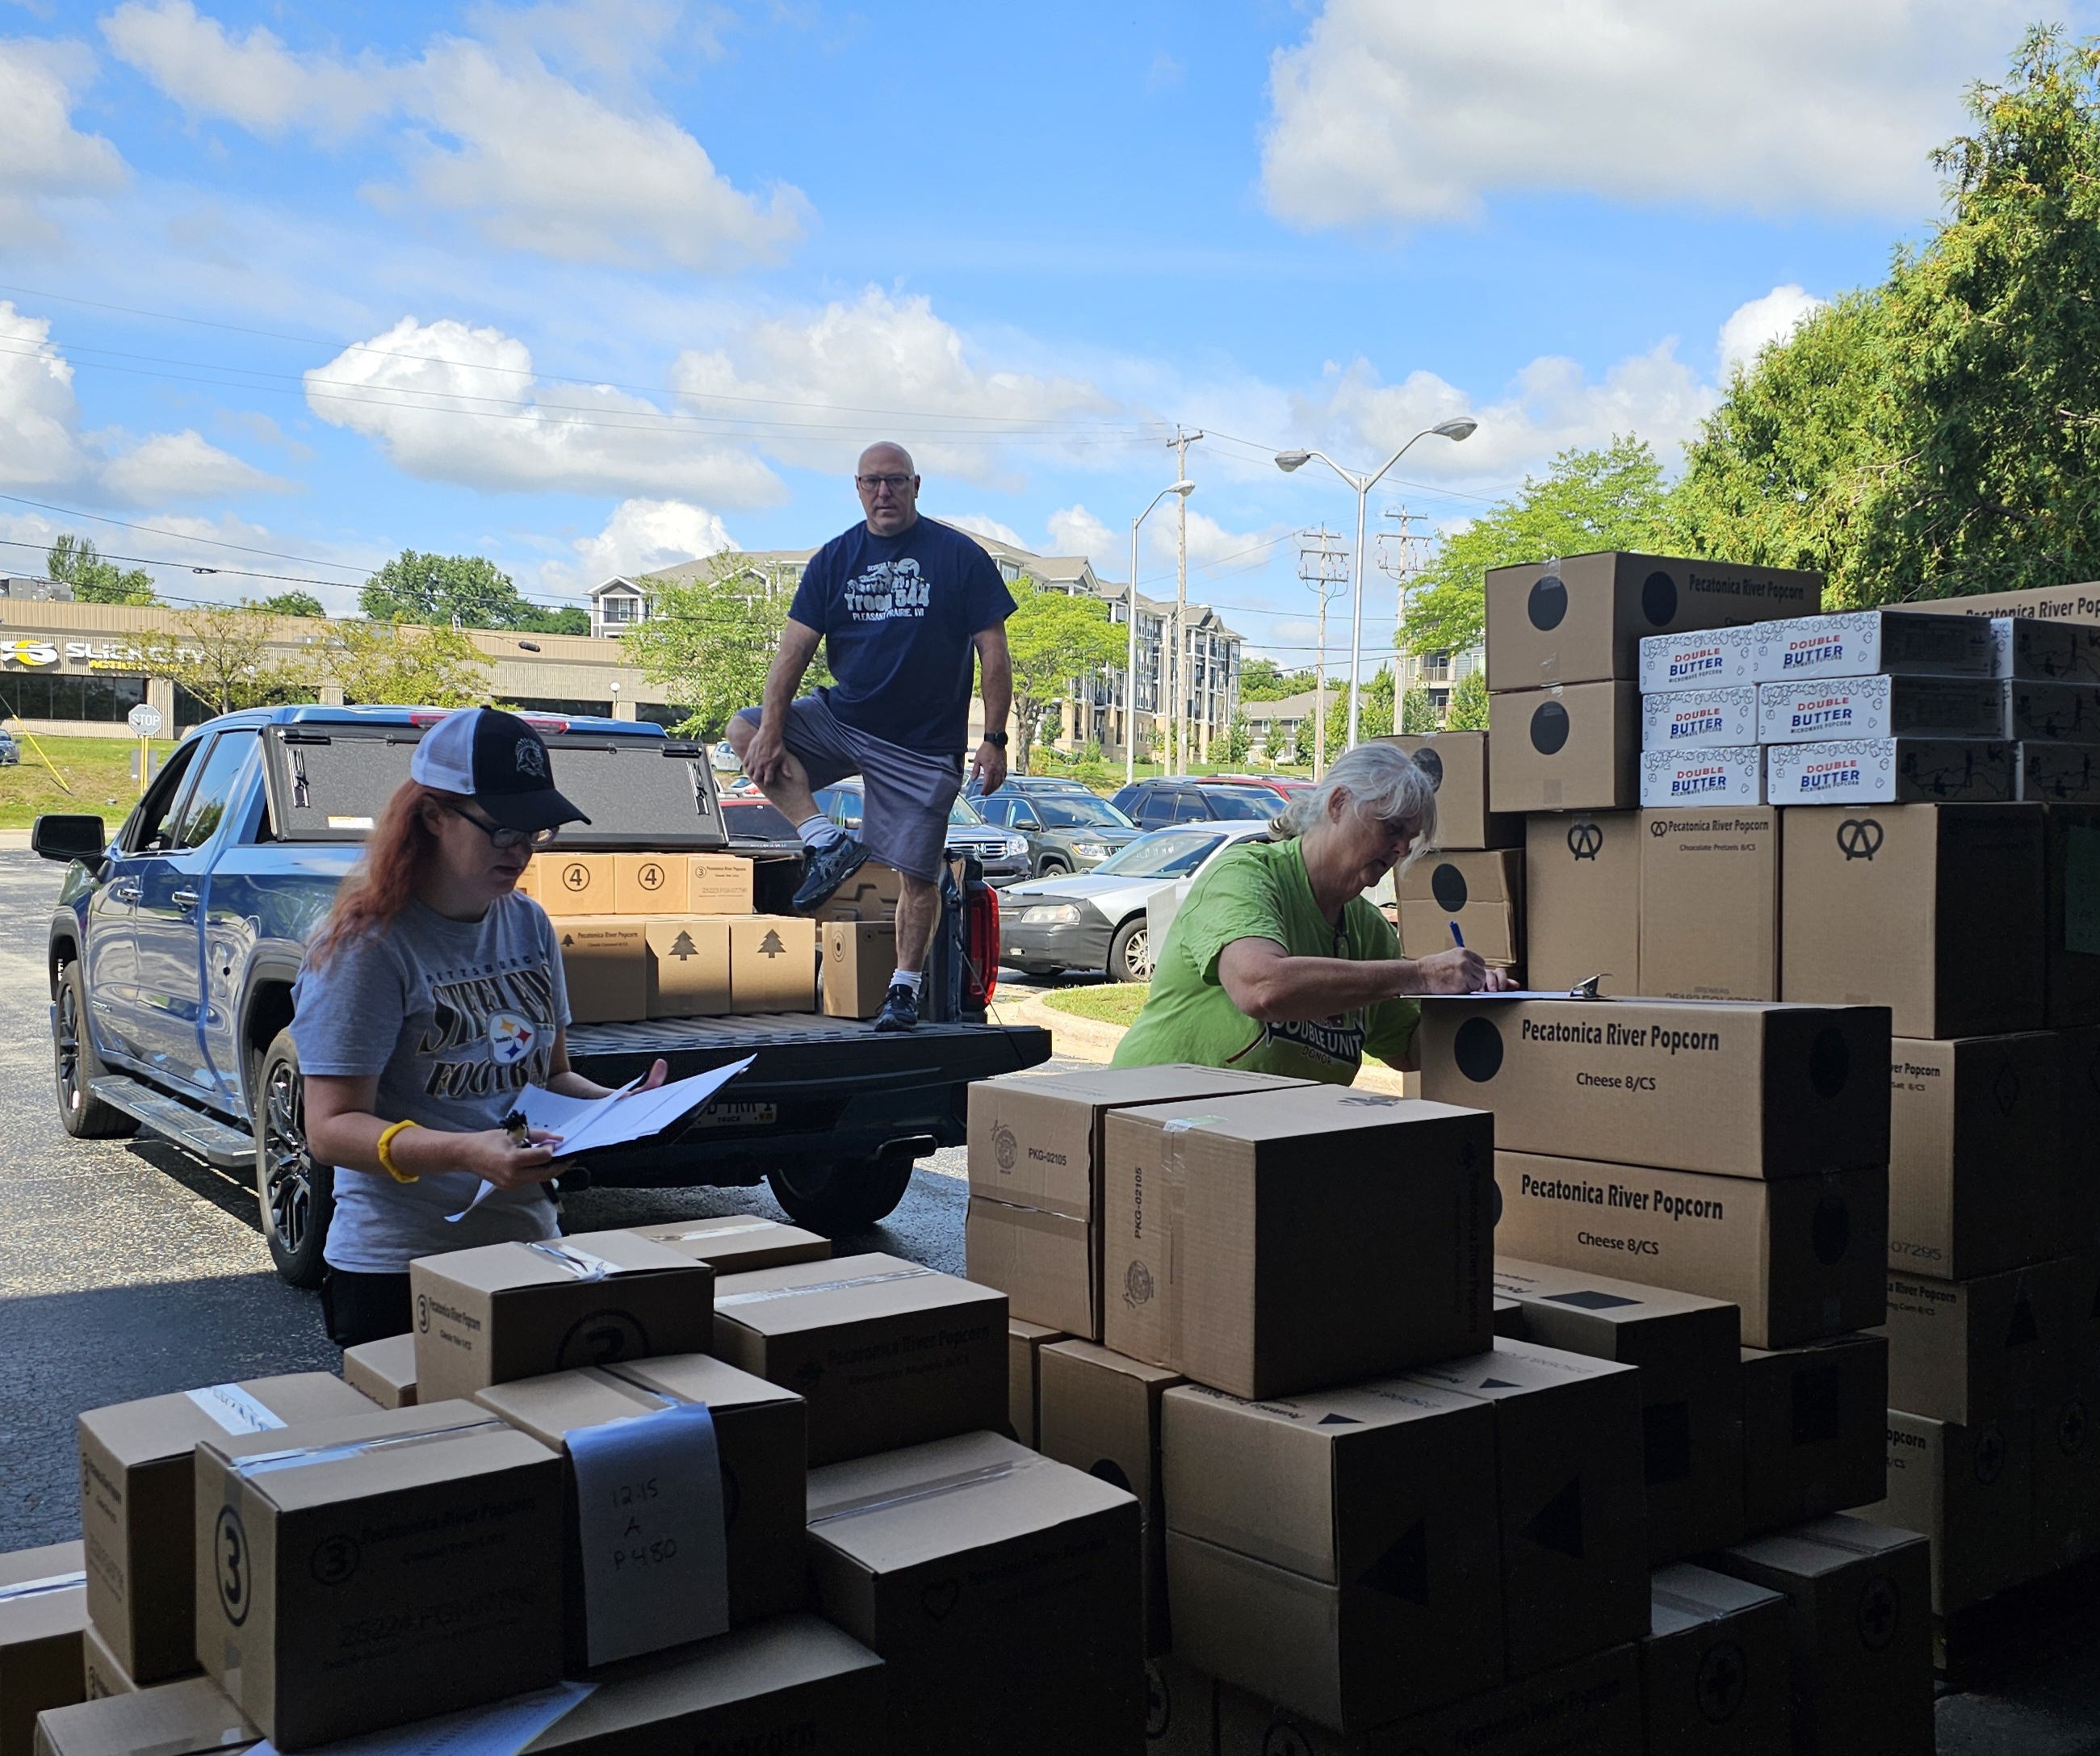
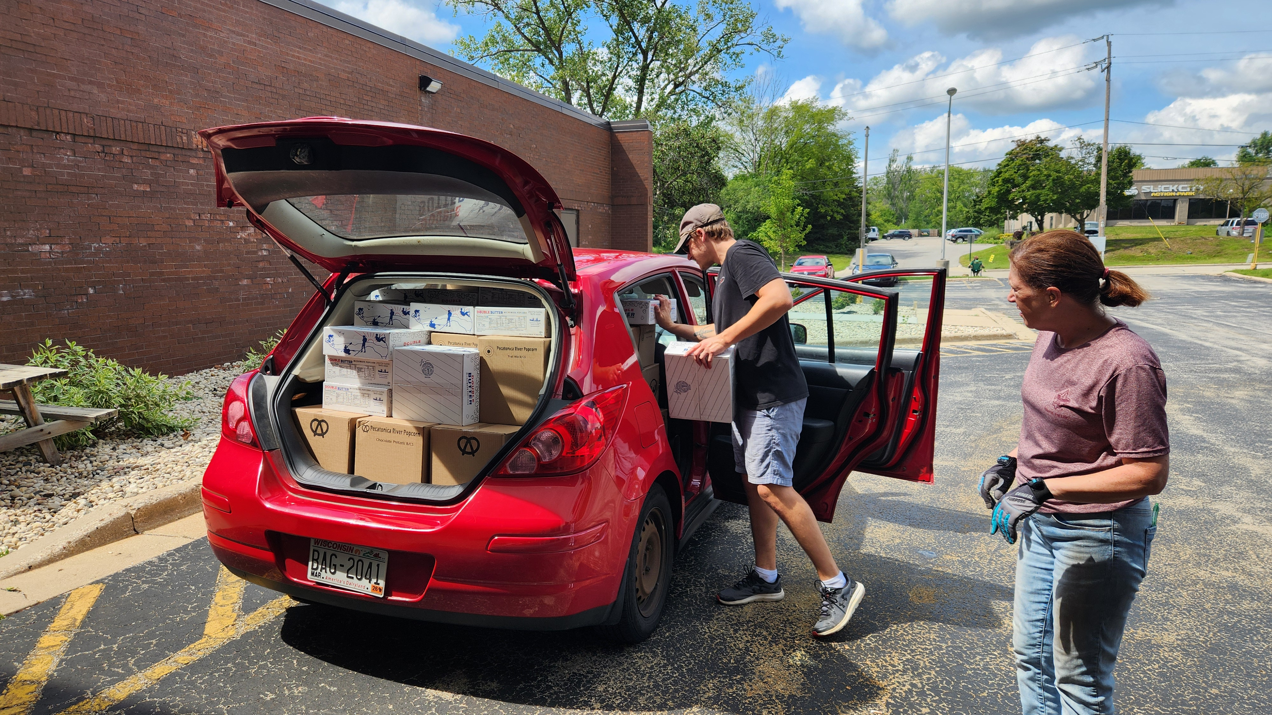
Volunteer Help Needed
Thursday, Aug. 20 | Friday, Aug. 21 | Thursday, Nov. 5 | Friday, Nov. 6
Popcorn Sort & Distribution days at CH Coakley
  Sort Orders
  Prep for Pickup
  Help load orders into vehicles

Slide 29

Three Harbors Council
Product Sale Website
F
The Product Sale Insider (emailed newsletter)
Popcorn Resources
Wreath Resources
1K Club Sign Up
Top Seller Event Sign Up

Slide 30
Fund the Scouting Journey
Cubs Needs 28% 30% 32% 34% 20% + 5%
$350 $1,250 $1,167 $1,094 $1,030 $1750+87.5
$400 $1,430 $1,335 $1,250 $1,176 $2000+100
$500 $1,785 $1,667 $1,563 $1,471 $2,500+125
Troops Needs
$500 $1,785 $1,667 $1,563 $1,471 $2,500+125
$1000 $3,570 $3,333 $3,125 $2,940 $5,000+250
$3000 $10,714 $10,000 $9,375 $8,825 $15,000+750

Slide 31
Fund the Scouting Journey
Popcorn in 2025 our Scouts sold:
$1000 + 125
$1250+ 105
$1500+ 58
$2000+ 25
$3000+ 18
Wreaths in 2025 our Scouts sold:
$1000 – 22
$1500 – 9
$2000 – 2
$2500 – 2
Top Sellers
$7657
$6029
$4104
$4043
Top Sellers
$3000 - 1
$3672
$2700

Slide 32


QUESTIONS?

