Slide 1
Southern Shores District
THREE HARBORS COUNCIL ROUNDTABLE HIGHLIGHTS
April 2020

Slide 2
COVID19 UPDATE
All Council Activities & Camps Closed until May 18.
  Current guidelines from State end April 24, and the US President has extended the voluntary shutdown until May 1; with both possibly extending

Slide 3
COVID-19 Opportunity!
The Medical College of Wisconsin and Rebel Converting have partnered to make masks for vulnerable community members.
Service opportunity for Scouting families to make masks.
Contact Ryan Spellecy if interested rspellecy@gmail.com
https://www.cbs58.com/news/saukville-company-rebel-converting-donating-kits-to-help-make-millions-o
Notes:
VO

Slide 4
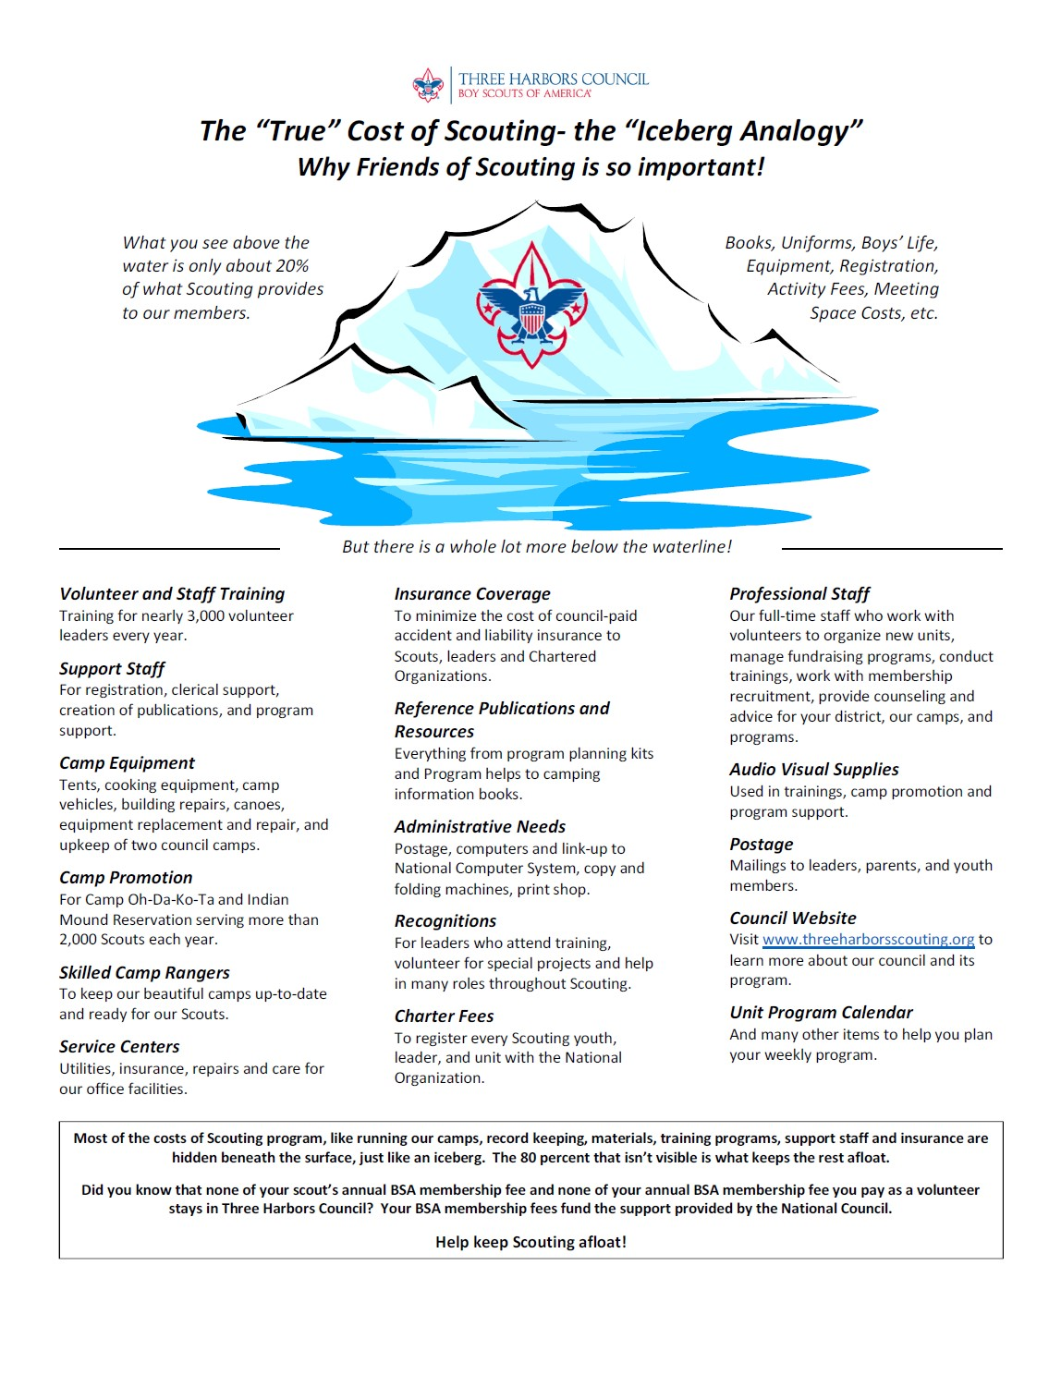
Family Friends of Scouting
Provides funds to help maintain lower direct costs to families for council programs and services
FOS donations given to Three Harbors Council stay in Three Harbors Council
Conduct Virtually by Apr 30, 2020
  To have a virtual Presentation contact your District Professional, or FOS Chair
Inform families in advance that presentation is scheduled
All families given the opportunity to make a voluntary contribution
Support One Scout = $180 in 2020

Slide 5
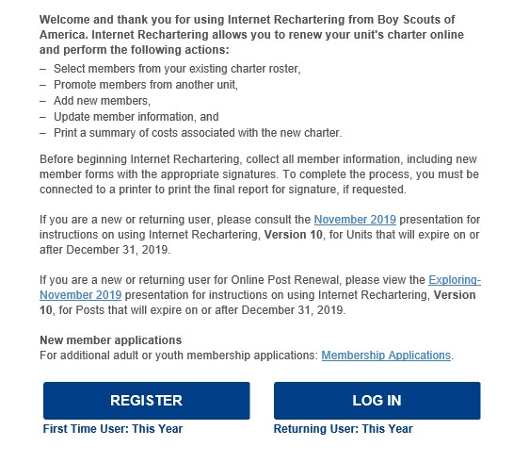
Rechartering
NEW
Recharter cycle adjustment – moving all units to December 31 starting in 2020; NO ONLINE PAYMENT
New BSA membership fees & Unit Charter Fee
Adult Criminal Background Recheck Disclosure Forms
REMINDER
Current Youth Protection Training
$2 Council Insurance Recovery Fee
ALL UNIT RECHARTER PAPERWORK NOT YET SUBMITTED IS CURRENTLY PAST DUE. PER BSA MEMBERSHIP GUIDELINES, DECEMBER UNITS THAT HAVE NOT COMPLETED RECHARTER WERE DROPPED ON MARCH 1; JANUARY UNTIS WILL BE DROPPED ON APRIL 1.
http://www.threeharborsscouting.org/resources/re-charter/54689

Slide 6

Spring Popcorn Sale
Show & Sell postponed.
Take order Still on, please use social distancing guidelines, sell over phone, social media etc.

Slide 7
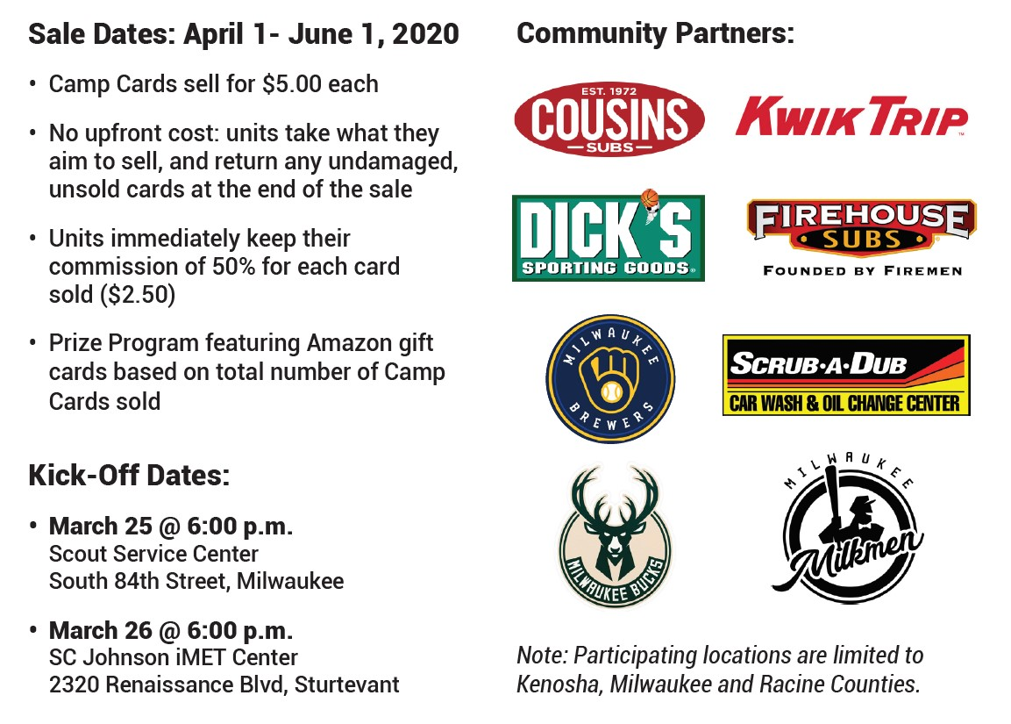
Camp Card Unit Fundraiser

Slide 8
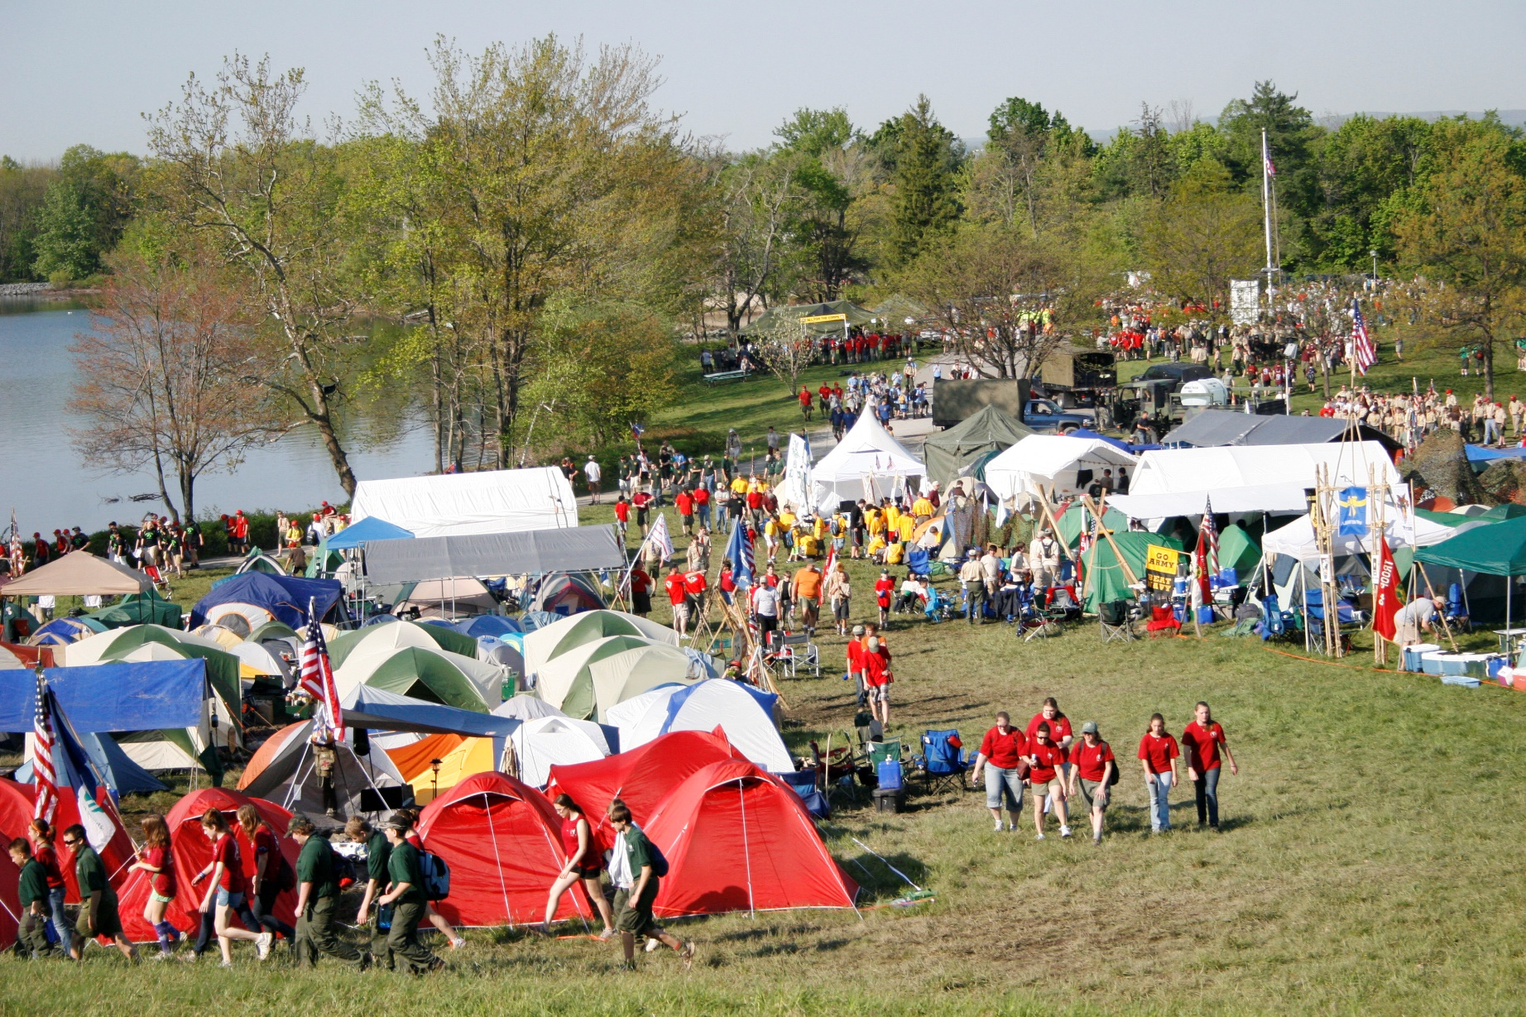
Upcoming Council Events
Council Camporee
May
29-31 – Scouting the Zoo
Summer
Council Annual Meeting & Silver Beaver Recognition Event
September 25-27
Racine County Fairgrounds

Slide 9

2020 Summer Camp
Day Camp
Webelos Weekend
“Fry” Day Fish Derby
Family Weekend
Shooting Sports Day
Wilderness Overnight
In-Town Day Camp
Scouts BSA Shooting Day
Camp Ammon
http://www.threeharborsscouting.org/camping/summer-camp/61330

Slide 10
Advancement Updates
Cub Scout Packs
  Adventures can be done from home with the family
  Host Virtual Activities with Dens & Pack
  Share the Cub 30 day challenge with Pack families
  Pack or Den Service Project
Scouts BSA
  Virtual Troop meetings
  Rank Advancement/MB
  SM Conferences/BOR
  No Eagle binder drop off.
  Email required Eagle forms to karla.langoehr@scouting.org
  Contact Heather for EBOR

Slide 11
Online Merit Badges
Personal Fitness Merit Badge
  April 15th at 7:00 pm
Personal Management Merit Badge
  April 18th at 10:00 am
Genealogy Merit Badge
  April 18th at 9:00 am
Art Merit Badge
  TBD
Are you a Merit Badge Counselor?
Volunteer today to host an online class!

Slide 12
Council Virtual Campfire
Join the Campfire from your Home
Please join us for Three Harbors Council’s first ever “Virtual Campfire” program on Wednesday, April 8th at 7:00 p.m.! All Scouts, leaders and families are invited to join in. Campfire details, including how to watch the virtual program, will be announced via social media on Monday.

Slide 13
Southern Shores District Roundtable Program
Topic
  Virtual Meetings with Derrick Paquette
April 11th at 11:30 am
  Zoom Lunch and Learn Training
  Hosted by Scouts BSA and Cub Leaders

Slide 14
“Virtually scouting”
Disclaimer – Some people may disagree with what I am about to say…

Slide 15
Agenda
Why Adapt?
Rethinking your Unit Structure
Networking Tools
Online Forums

Slide 16
Why Adapt?
The unsurety of the current situation
If restructured properly there are great tools to cut out the nonvalue added Scout work
Do you work hard to pass out info out or take collect it?

Slide 17
How is your Unit Setup?
When we started Troop 579 B & G we decided to structure the tech like a business.
  We started with a Troop G-mail account
    That opened up all the Google apps for us

Slide 18
Moving to an online tracking system
Why?
  To make your job easier…
    Helps with guiding your PLC
    Right now you can look up who needs what without their books
“We did not switch because a Scout needs to carry their book”
  That is fine to have the scout carry their book, make it easy on you.

Slide 19
Online tracking systems
Scoutbook
TroopWebHost
TroopMaster
Scoutlander
Probably many more

Slide 20











Google Productivity Tools

Slide 21
Networking Tools
Googles G-Suite
  Google Drive
  Google Forms
Unit e-mail
TroopWebHost/Scoutbook/Troopmaster/Scoutlander

Slide 22
Meeting online
Ease into it
Pick the best forum:
  Large Group Interactive with Video (Den, PLC, Troop meeting, Merit Badge Workshops)
    Zoom
    Microsoft Teams
  Small Groups Interactive with Video (Rank sign offs, Merit Badges)
    Google Hangout
    Google Duo
    Facetime Videocall
    Facebook Messenger Videocall
  Complimenting Services/Tools
    Kahoot
    Jeopardy (PowerPoint template)

Slide 23
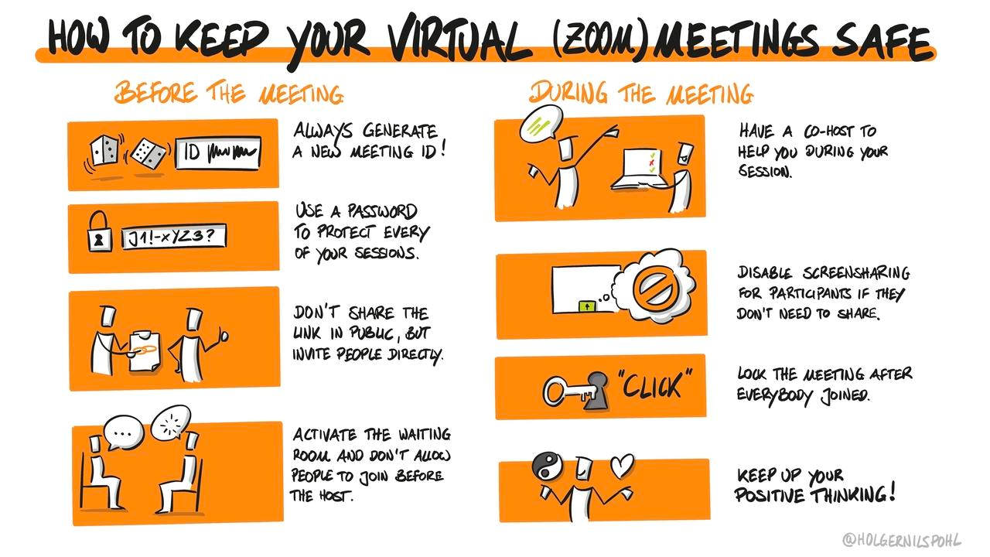
Meeting Safety

Slide 24
Google Classroom
Create a classroom for Specific items
  Each classroom is independent of each other
  Able to:
    Post documents,
    PowerPoints,
    Announcements
    Questions for Discussion
    Have Assignments for each requirement

Slide 25
Youth Protection
As always use the most recent policy when doing anything
In Forums, Classrooms, video calls, e-mails ensure there are 2 registered leaders
It is as much to protect you as it is the Scout

Slide 26
Feedback???
Please feel free to reach out with any questions, tricks, or techniques you have.
paquette187@gmail.com

